Slide 1
Tree I

Slide 2
Path and circuit

Slide 3
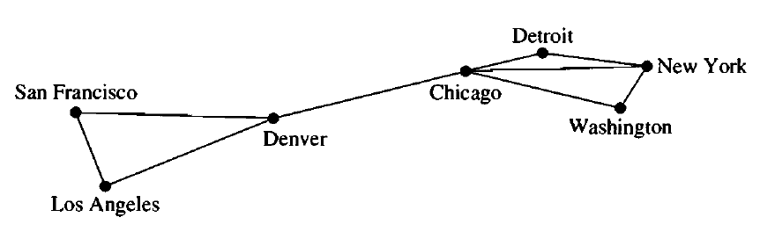
Path and Circuit
A path is a sequence of edges that begins at a vertex of a graph and travels from vertex to vertex along edges of the graph.
There is a path from SF to NY
The path length is 3

Slide 4
Path and Circuit
The path is a circuit if it begins and ends at the same vertex,
that is, if u = v, and has length greater than zero.
There is a circuit from Detroit to Detroit via NY, Washington and Chicago
The cycle length is 4

Slide 5
Path and Circuit
A path with no repeated edge is a simple path
A circuit with no repeated edge is a simple circuit

Slide 6
Path and Circuit
A connected graph is graph that is connected in the sense of a topological space, i.e., there is a path from any point to any other point in the graph.

Slide 7
Understanding trees

Slide 8

Trees
Nobody:
Absolutely nobody:
Computer scientists:

Slide 9
Trees
A tree is a connected undirected graph with no simple circuits
Because a tree cannot have a simple circuit, a tree cannot contain multiple edges or loops.
Therefore any tree must be a simple graph

Slide 10
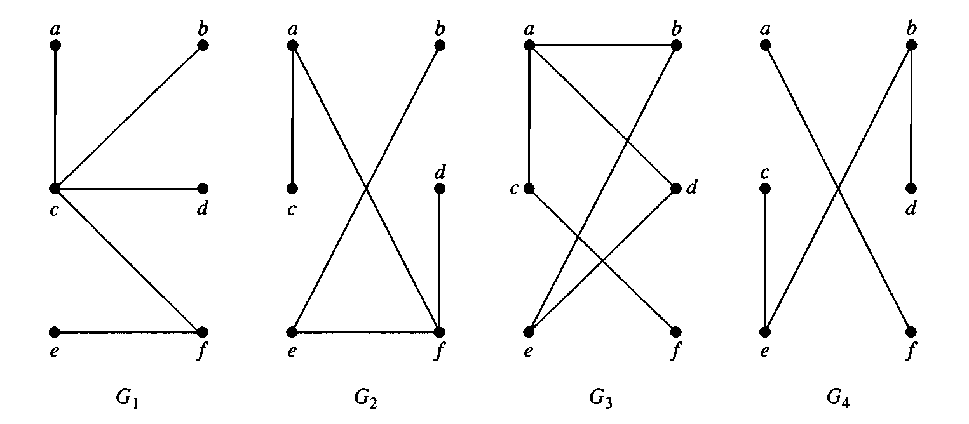

Which of the following are trees?

Slide 11
Rooted Trees
A rooted tree is a tree in which one vertex has been designated as the root and every edge is directed away from the root.

Slide 12
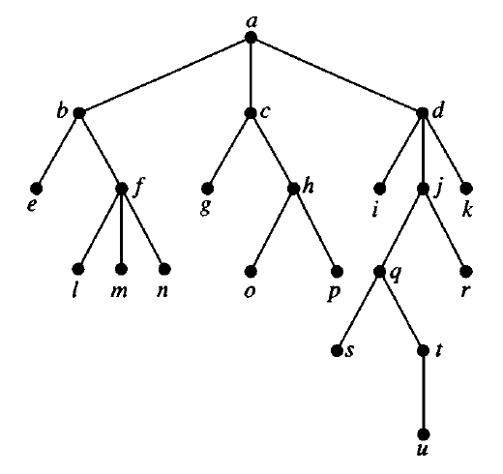
Some terminologies related to rooted trees
Root of the tree

Slide 13
Some terminologies related to rooted trees
Internal vertices

Slide 14
Some terminologies related to rooted trees
Leaves

Slide 15

Some terminologies related to rooted trees
Children of $j$

Slide 16

Some terminologies related to rooted trees
Parent of $h$

Slide 17
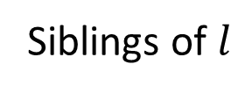
Some terminologies related to rooted trees
Siblings of $l$

Slide 18
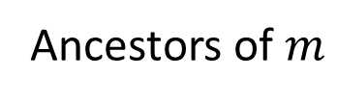
Some terminologies related to rooted trees
Ancestors of $m$

Slide 19
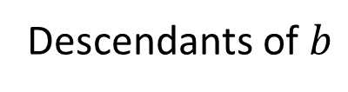
Some terminologies related to rooted trees
Descendants of $b$

Slide 20
m-ary tree
A rooted tree is called an m-ary tree if every internal vertex has no more than m children.
The tree is called a full m-ary tree if every internal vertex has exactly m children.
An m-ary tree with m = 2 is called a binary tree

Slide 21
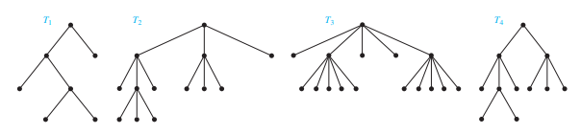
m-ary tree
Full (2-ary)
Binary
Tree
Full 3-ary
Tree
Full 5-ary
Tree
3-ary
Tree

Slide 22
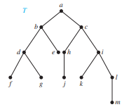
Ordered Rooted Trees
What are the left and right children of d in the binary tree T shown in the given figure (where the order is that implied by the drawing)? What are the left and right subtrees of c?

Slide 23
Properties of trees

Slide 24
Properties of Trees
Theorem 2 : A tree with n vertices has n − 1 edges
Let us use the mathematical induction technique to prove this statement.
Theorem 3: A full m-ary tree with i internal vertices contains n = mi + 1 vertices.
Theorem 4: A full m-ary tree with
(i) n vertices has i = (n − 1)/m internal vertices and l = [(m − 1)n + 1]/m leaves,
(ii) i internal vertices has n = mi + 1 vertices and l = (m − 1)i + 1 leaves
(iii) l leaves has n = (ml − 1)/(m − 1) vertices and i = (l − 1)/(m − 1) internal vertices

Slide 25
Properties of Trees
Example 9 : Suppose that someone starts a chain letter. Each person who receives the letter is asked to send it on to four other people. Some people do this, but others do not send any letters. How many people have seen the letter, including the first person, if no one receives more than one letter and if the chain letter ends after there have been 100 people who read it but did not send it out? How many people sent out the letter?

Slide 26
Height of tree and level of nodes (vertices)

Slide 27
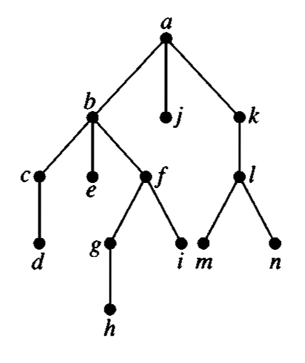
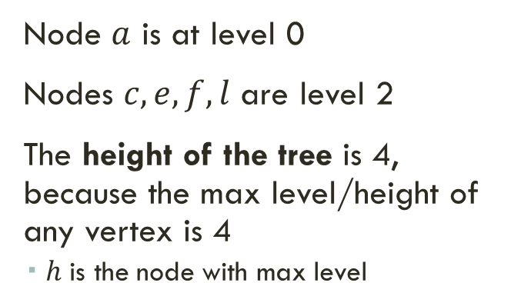
Height and level/depth of nodes
Node $a$ is at level 0
Nodes $c,e,f,l$ are level 2
The height of the tree is 4, because the max level/height of any vertex is 4
$h$ is the node with max level

Slide 28
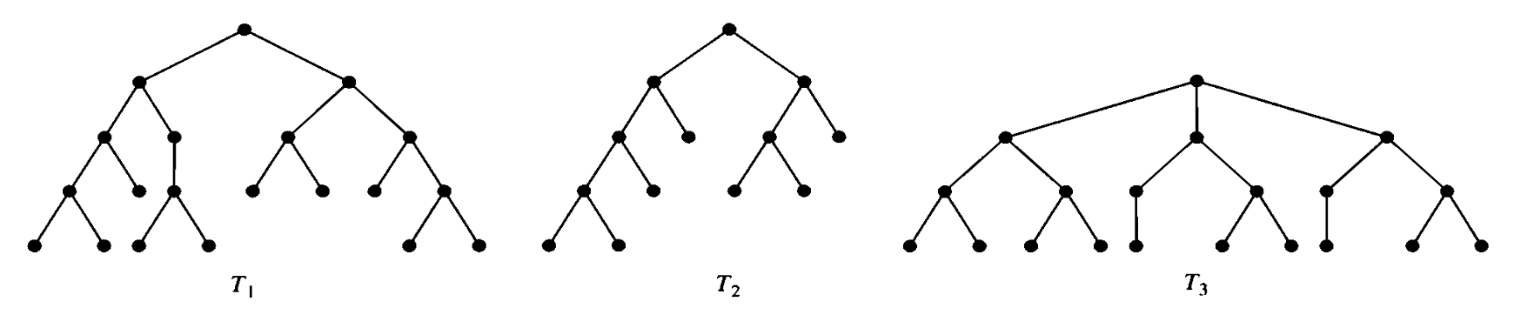
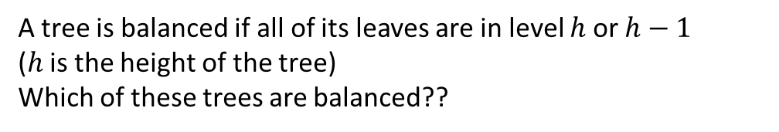
Balanced tree
Balanced
Unbalanced
Balanced
A tree is balanced if all of its leaves are in level $h$ or $h−1$ ($h$ is the height of the tree)
Which of these trees are balanced??

Slide 29
Theorem 5
THEOREM 5 : There are at most m^{h} leaves in an m-ary tree of height h
Let us prove this using mathematical induction

Slide 30
Thank You

